Slide 1
Portable A.i based distraction and drowsiness detection system
Presented by AUTONOMOUS

Slide 2

INtroduction
We developed a portable, AI-powered driver monitoring system designed to detect driver drowsiness and distraction in real time. When the system identifies signs of reduced alertness or unsafe driving behavior, it makes a warning sound to warn the driver and encourage them to stay focused, helping improve road safety and reduce the risk of accidents
And We are the team Autonomous. The founder of this system.

Slide 3
Why we need to make this system?

Slide 4
Of the accidents are caused due to driver inattention in 2024 secondary highway accidents in South Korea.
76%

Slide 5
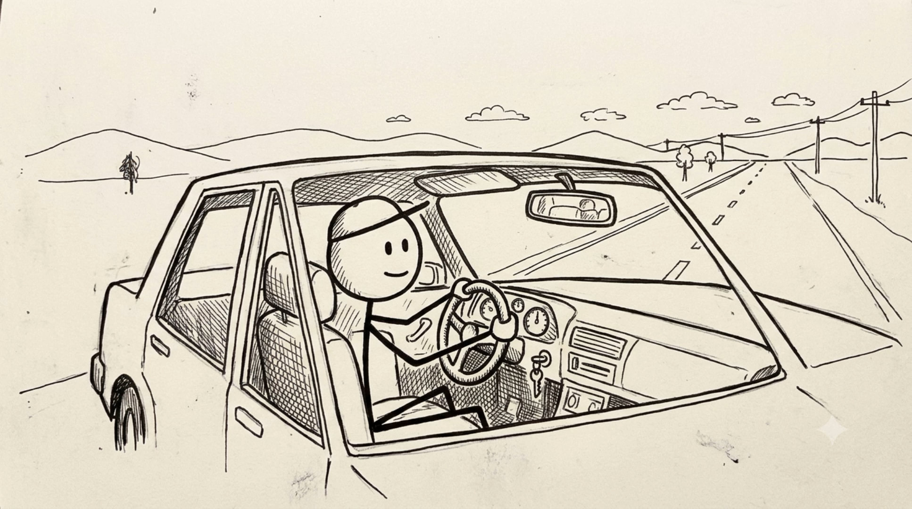

Slide 6
Let’s look at the picture
How our system works..

Slide 7
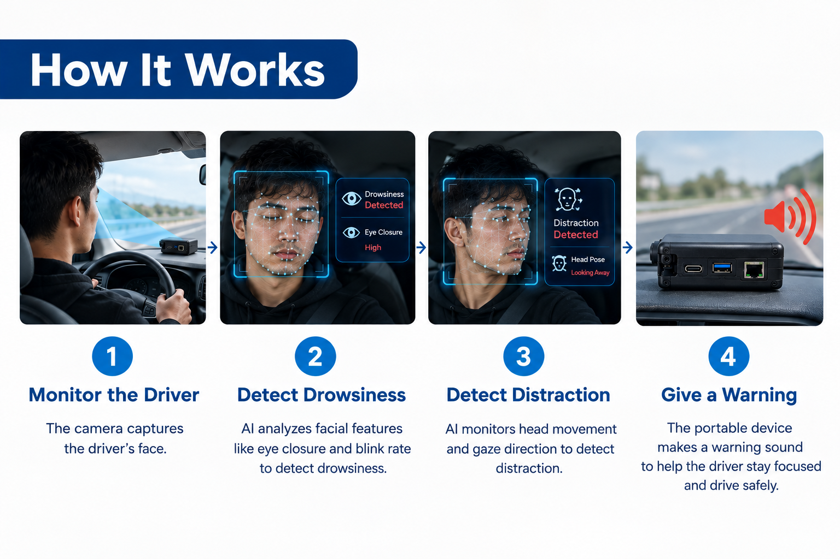

Slide 8
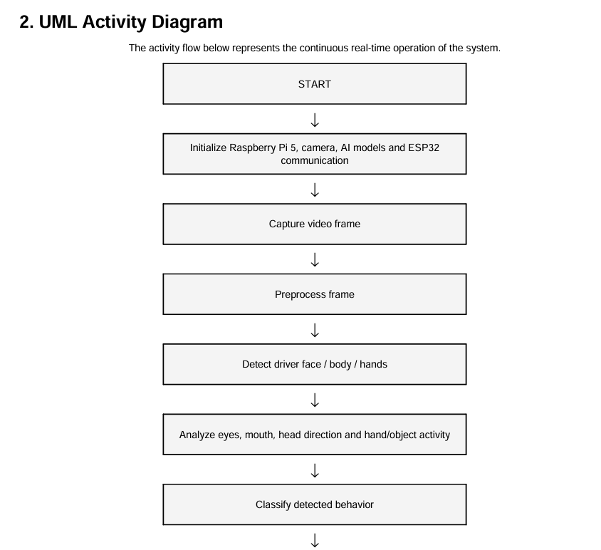
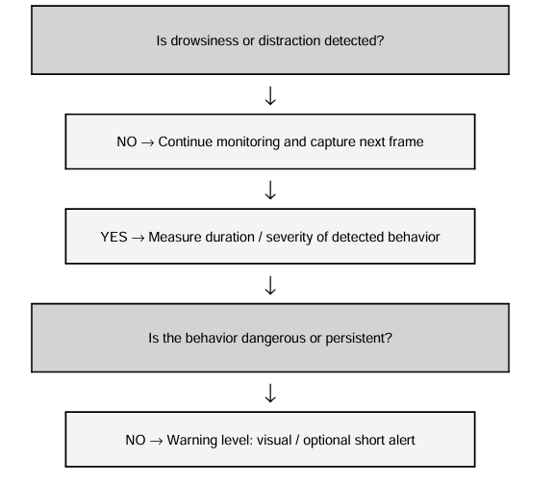

Slide 9
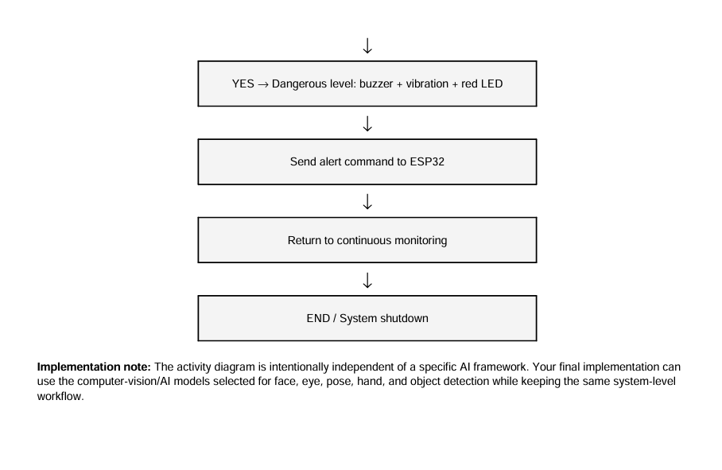

Slide 10
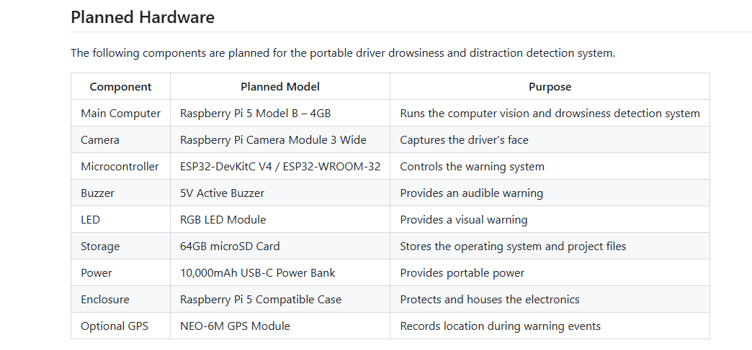

Slide 11
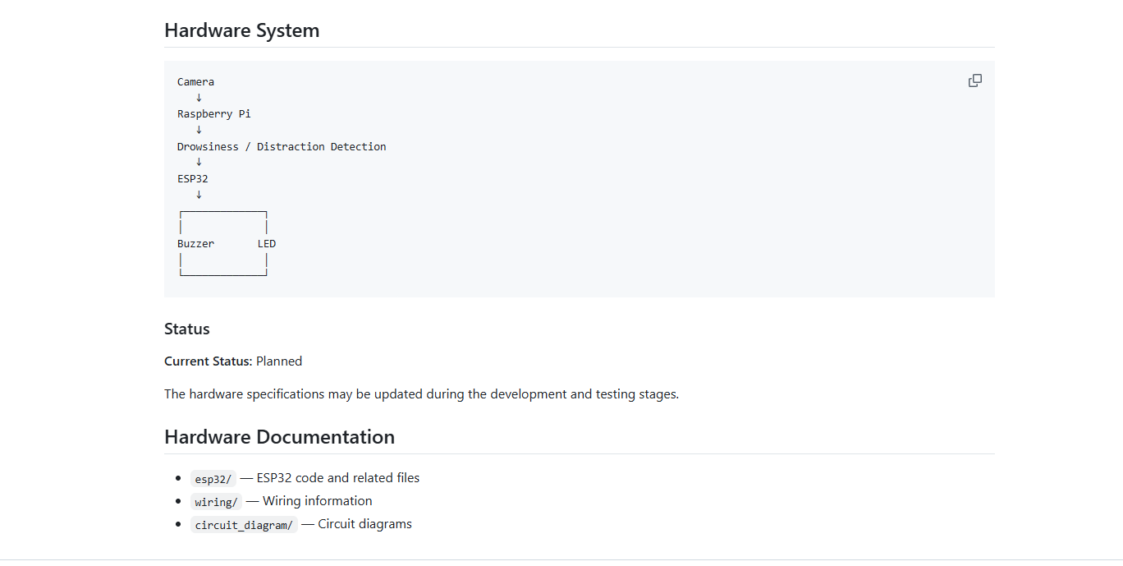

Slide 12
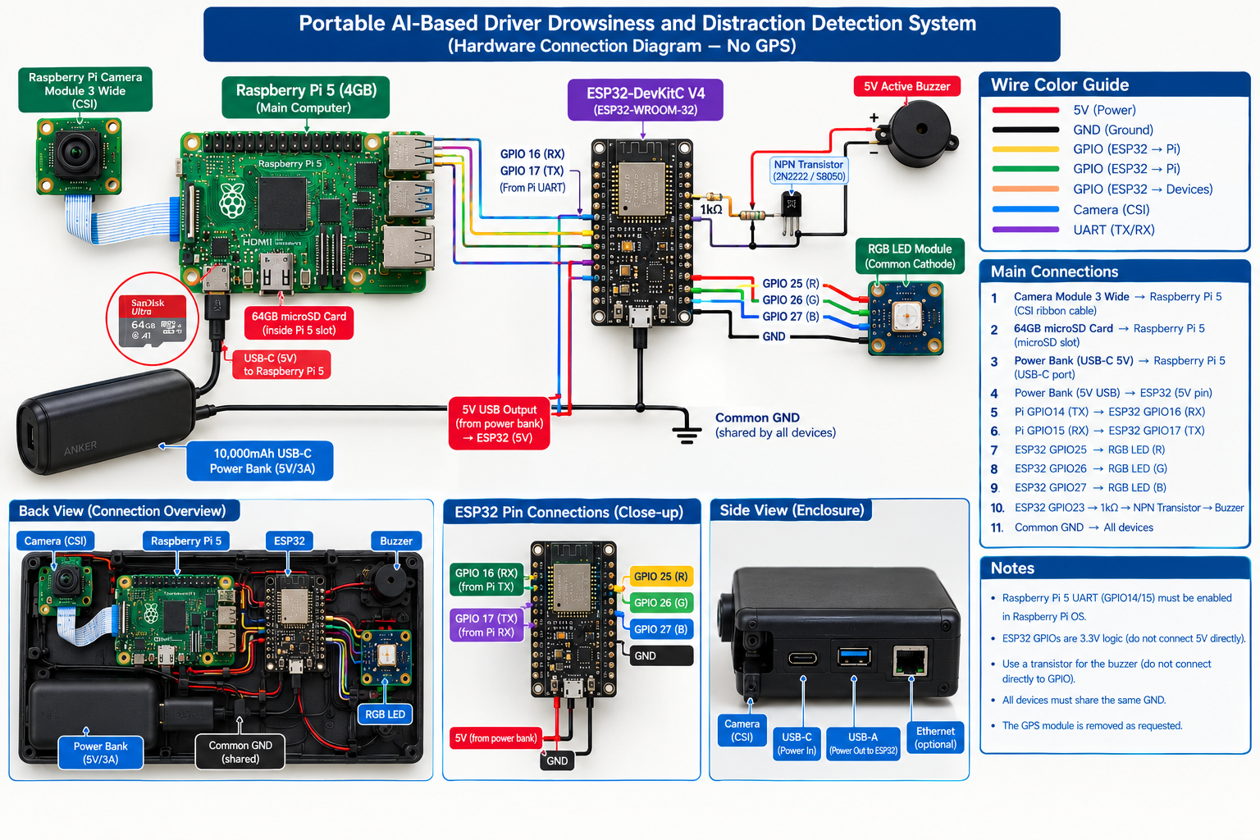

Slide 13
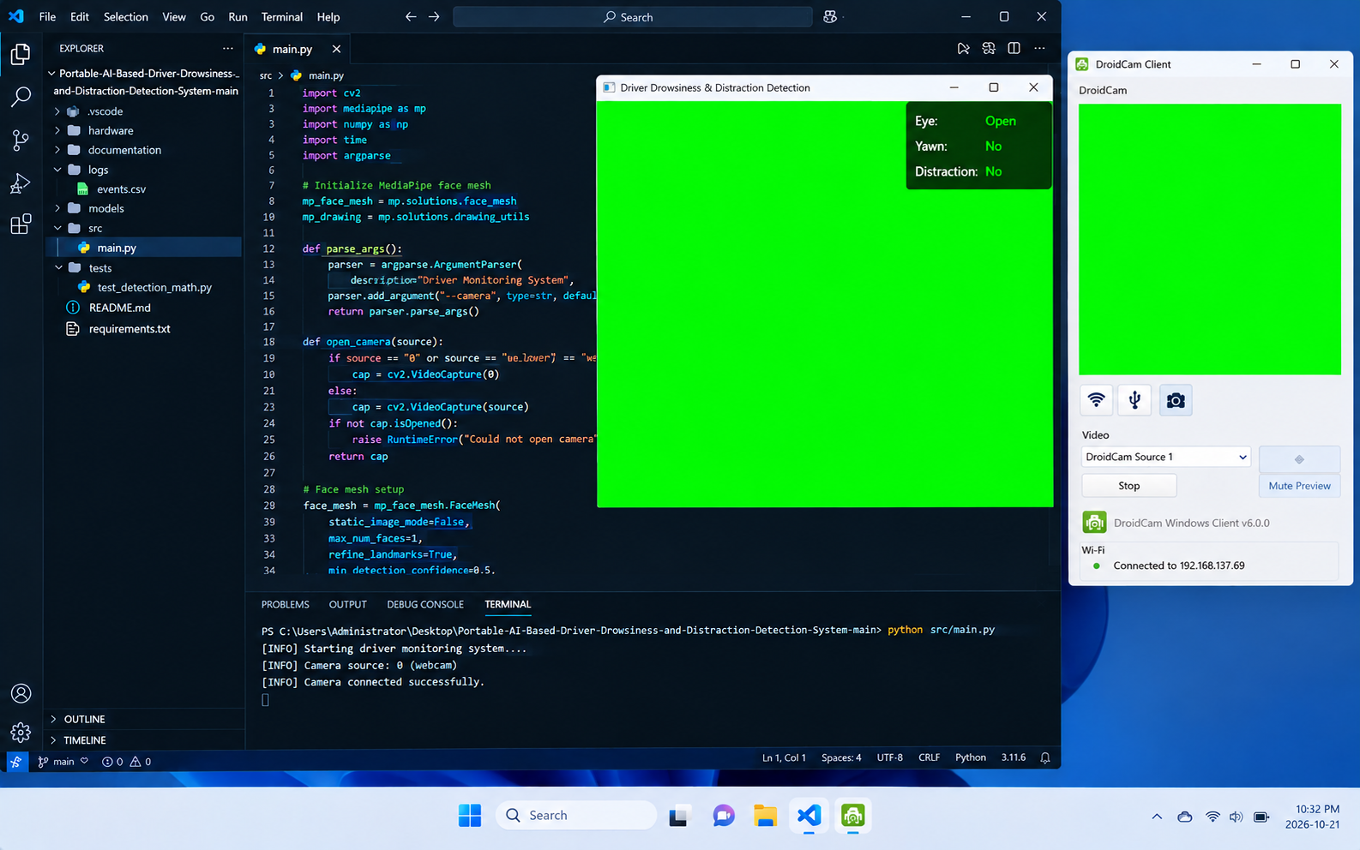
Software status
Our system is currently under development and testing. We are using DroidCam to connect a mobile phone camera to the PC as a virtual camera for testing. However, we are currently facing an issue where the system cannot detect the camera properly. We are working to resolve this issue.

Slide 14

Q & A

